Slide 1
CHAPTER 3 Well posed predictive control 7 unstable processes
Anthony Rossiter

Slide 2
Introduction
The previous videos indicated many problems in doing GPC of unstable processes.
Although the closed-loop control laws often are stabilising and appear to give reasonable performance, the underlying predictions are often far from desirable trajectories.
This mismatch, between optimised trajectories and actual behaviour, indicates that the optimisation is ill-posed and thus the solutions could be seriously flawed.
This video introduces the simple concepts in the literature for ensuring a well-posed optimisation and indicates the more well accepted techniques to be discussed in a later chapter.

Slide 3
Open-loop instability
The main problem with open-loop unstable systems is that the coefficients within the H, P, Q prediction matrices are divergent because the step response is divergent.
GPC is in essence saying, take a linear mix of divergent responses and give me a smooth response with a constant steady-state – clearly this is not a sensible set up.

Slide 4
Illustrate silly-mixing objective

Slide 5
Summary of conditioning problem
Because the step response coefficients are divergent, if one chooses a large output horizon, then the H matrix could simultaneously contain values from say 1 up to 10¹⁶ and greater.
In this instance, the smaller values may be rounded to zero as software will generally store only a given range within a single matrix.
Similarly, when forming products such as H^{T}H, there will be numerous rounding errors introduced.
The consequence is that the control law parameters could be dominated by rounding errors and not the optimisation and may have little meaning.

Slide 6
Illustration of rounding problem
Plot the coefficients of N_{k}, for changing values of ny and nu=2.
Constant once ny large enough
Ill-conditioning and rounding errors cause problems

Slide 7
Conceptual solution
We have two challenges
Ensure the predictions we want to mix to make up an ideal prediction at least have shapes close to what we want.
Eliminate divergent signals from H,P, Q to avoid numerical ill-conditioning.
A simple solution is to find the set of future inputs which will ‘cancel’ the unstable dynamics and thus, by using only these, the prediction class within the optimisation will be convergent.
The algebra can be somewhat messy, so skip this if you like. A better solution comes in a later chapter.

Slide 8
Convergent predictions
Take the original prediction equations.
Express this in the form of z-transforms.
Factorise A(z) to have the unstable and stable poles.

Slide 9
Convergent predictions
The output predictions are convergent, if the poles are entirely stable, and therefore:
This gives us a simple restriction on the future control increments, that they must satisfy the following identity.

Slide 10
Convergent predictions
The fine details are omitted as now more of historical interest.
The key point is that the future control increments include a part that depends on past data (in vector p) and a totally free part captured in ψ.
One now needs to substitute this into the performance index, redo the optimisation and so forth.
A conceptually equivalent parameterisation/approach exists for state space models.

Slide 11
CONCLUSIONS
If a system is open-loop unstable, it is important to parameterise the predictions in such a way that they are convergent, before deploying them in the performance index.
This helps ensure both a well-posed optimisation and also avoids the danger of numerical ill-conditioning.
While algebra and pole cancellations are straightforward as indicated here, better alternatives using closed-loop prediction are more favoured now and hence will be discussed in a later chapter.

Slide 12



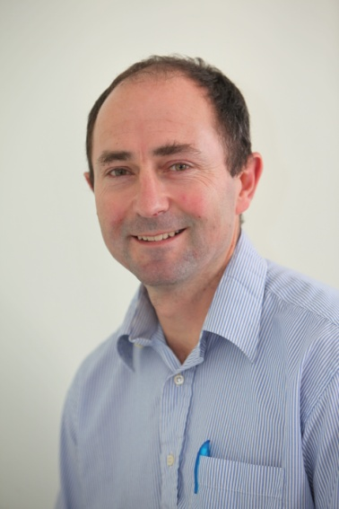
Anthony Rossiter
Department of Automatic Control and Systems Engineering
University of Sheffield
www.shef.ac.uk/acse
© 2014 University of Sheffield
This work is licensed under the Creative Commons Attribution 2.0 UK: England & Wales Licence. To view a copy of this licence, visit http://creativecommons.org/licenses/by/2.0/uk/ or send a letter to: Creative Commons, 171 Second Street, Suite 300, San Francisco, California 94105, USA.
It should be noted that some of the materials contained within this resource are subject to third party rights and any copyright notices must remain with these materials in the event of reuse or repurposing.
If there are third party images within the resource please do not remove or alter any of the copyright notices or website details shown below the image.
(Please list details of the third party rights contained within this work.
If you include your institutions logo on the cover please include reference to the fact that it is a trade mark and all copyright in that image is reserved.)

